Slide 2


Slide 3
GAME
Categories

Slide 4
animals | foods | weather | means of transport

Slide 5

Unit 8
Going away
Lesson 4 - Vocabulary and listening

Slide 6

How many different types of weather
can you say in English?
Do you like hot or cold weather?

Slide 7

use dictionaries
to check the meanings
of the words

Slide 8

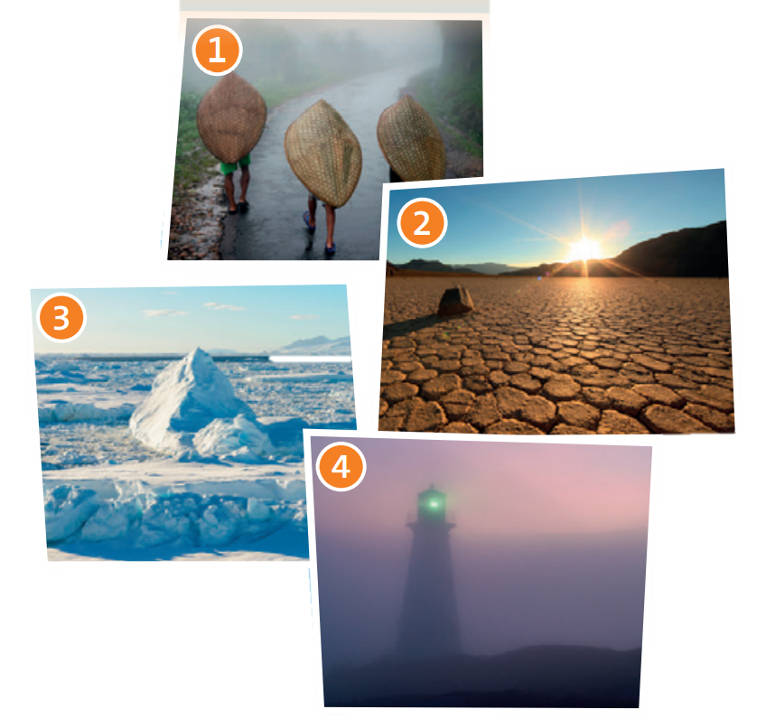
rainy, cloudy
hot, sunny
foggy, cloudy,
cold
cold, snowy, icy

Slide 9
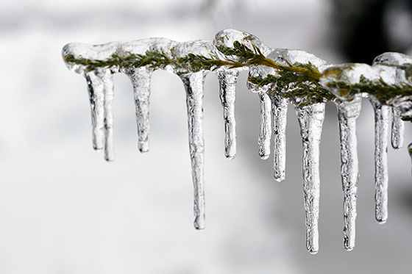

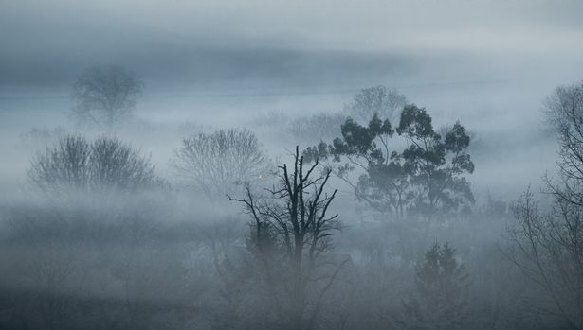
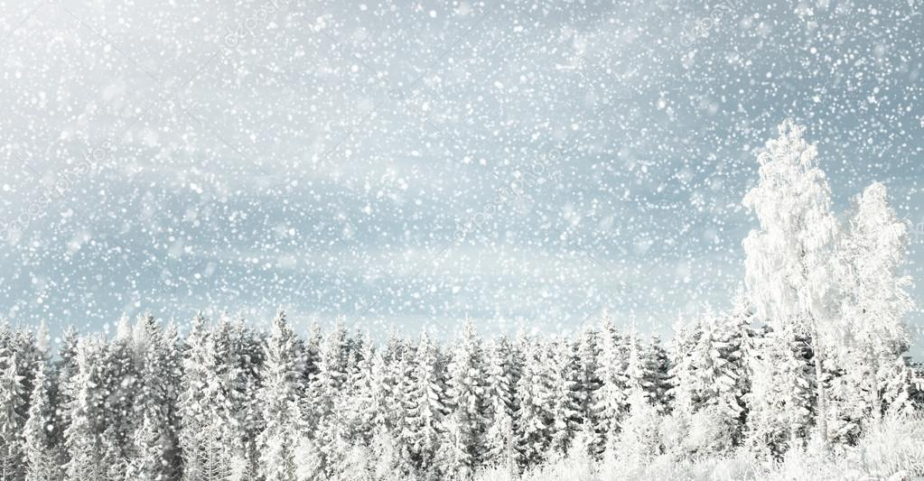
icy (adj) /ˈaɪ.si/
cloudy (adj) /ˈklaʊ.di/
foggy (adj) /ˈfɑː.ɡi/
snowy (adj) /ˈsnoʊ.i/

Slide 10
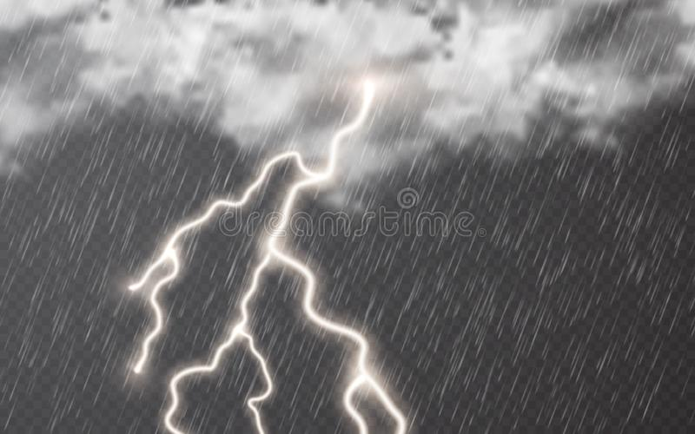
stormy (adj) /ˈstɔːr.mi/

Slide 11
New words
icy (adj) /ˈaɪ.si/
cloudy (adj) /ˈklaʊ.di/
3. foggy (adj) /ˈfɑː.ɡi/
4. snowy (adj) /ˈsnoʊ.i/
5. stormy (adj) /ˈstɔːr.mi/

Slide 12
Vocabulary check

Slide 13
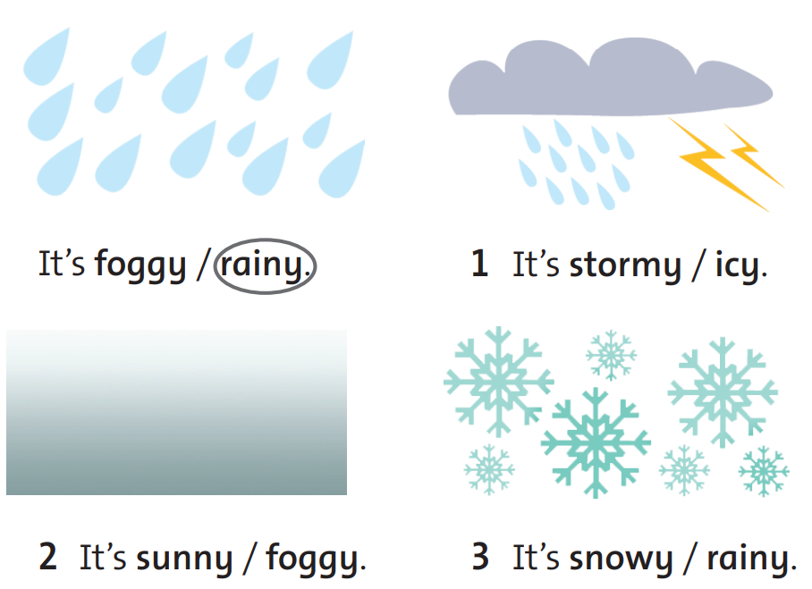

Slide 14
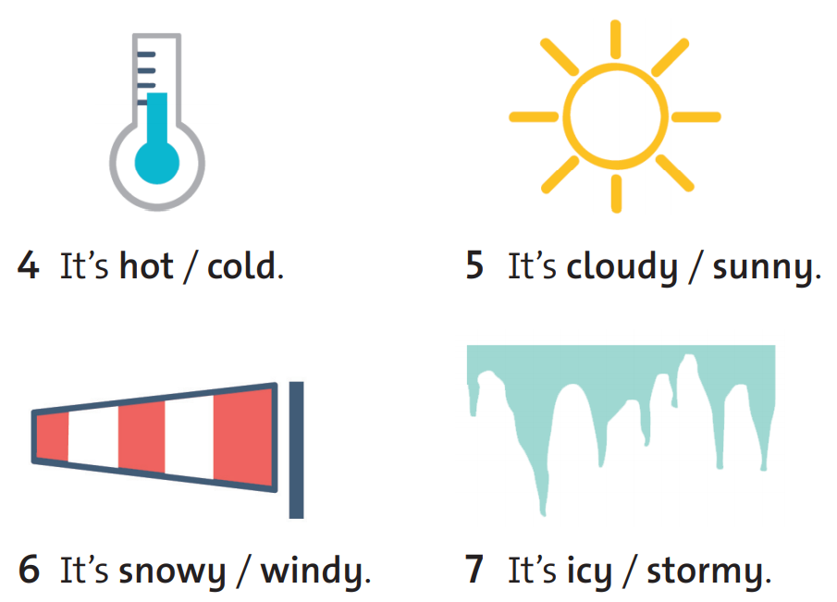

Slide 15
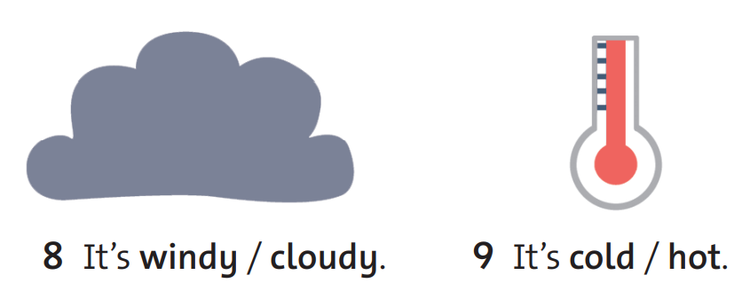

Slide 16

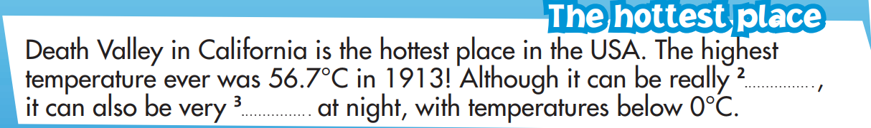
Complete the texts
EXERCISE 2
rainy
hot
cold

Slide 17
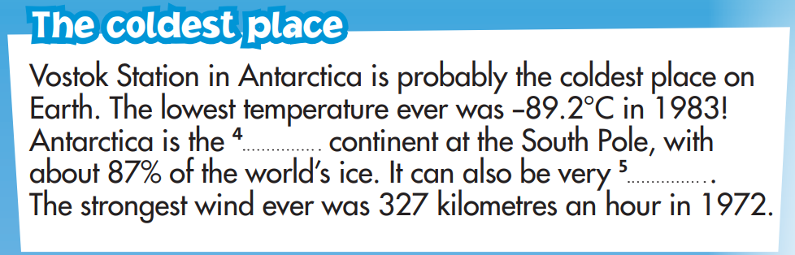
Complete the texts
EXERCISE 2
icy
windy

Slide 18
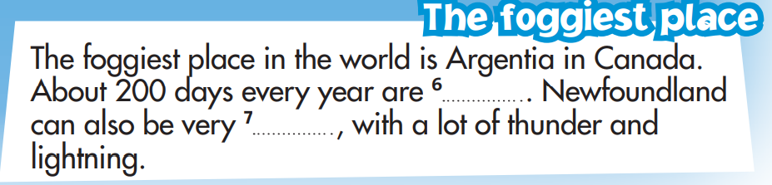
Complete the texts
EXERCISE 2
foggy
stormy

Slide 19
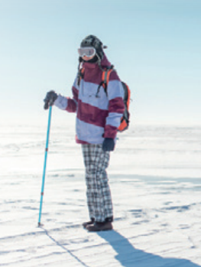
Stephanie Lowe
What do you think
she is going to do
in Antarctica?
She’s going to walk to the South Pole and study / take photos of the ice in Antarctica.

Slide 20
STUDY STRATEGY
Guessing answers before listening:
• Before listening, read the questions carefully.
• See how many answers you can guess

Slide 21
Guessing answers
EXERCISE 4
Are there any answers you
can guess now?

Slide 22
Choose the correct answers.
EXERCISE 5
1. Stephanie is also a …
a. teacher
b. photographer
c. doctor
2. 98% of Antarctica is …
a. ice
b. snow
c. water

Slide 23
Choose the correct answers.
EXERCISE 5
3. In Antarctica Stephanie will see … .
a. polar bears
b. polar bears and penguins
c. penguins and whales
4. 98% of Antarctica is …
a. ice
b. snow
c. water

Slide 24
Choose the correct answers.
EXERCISE 5
5. The temperature will be about …
-13°C
-33°C
-30°C
6. She’ll communicate with her friends and
family with a special … .
a. mobile phone
b. laptop
c. radio

Slide 25

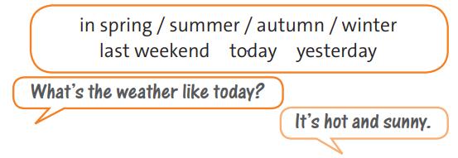

Slide 26
Work
in pairs

Slide 27

🍀 Learn by heart new words.
🍀 Workbook: Exercises page 56.

Slide 28



www.phuongnam.edu.vn

Slide 29



Thank you!
CTCP ĐẦU TƯ VÀ PHÁT TRIỂN GIÁO DỤC PHƯƠNG NAM

